Slide 1
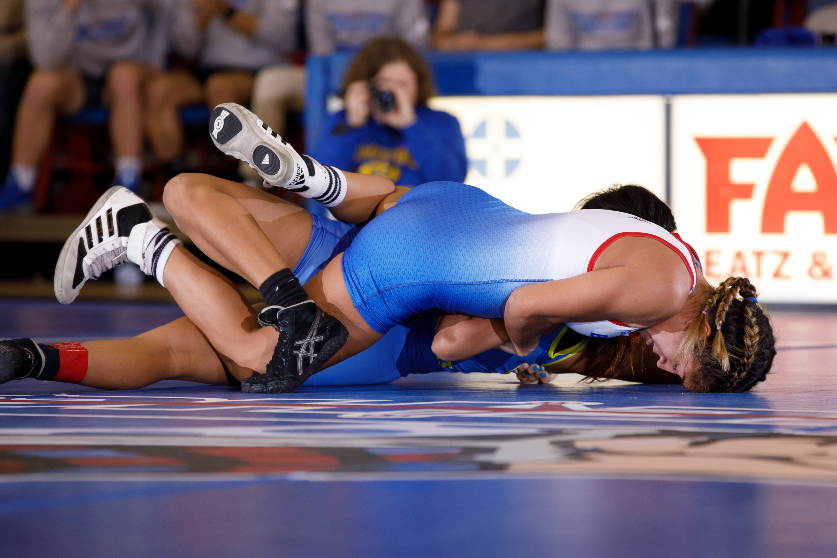
Parents guide to wrestling in college
What you need to know

Slide 2
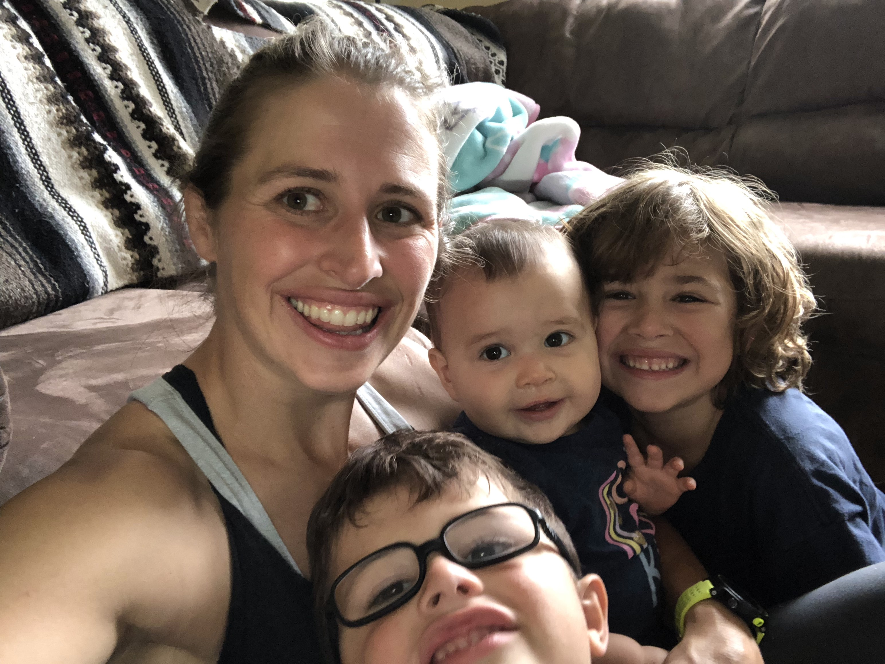
Dany DeAnda
Backround
Kailua HS Grad
College Northern Michigan University
Coached at several institutions
Currently at Presbyterian College in South Carolina
PC is the only NCAA Division 1 school with women’s wrestling

Slide 3



History of Women’s wrestling
80 colleges with women’s programs
In the NAIA, NCAA and NJCAA
Women’s wrestling is growing rapidly

Slide 4
What to look for in a college
What you need to know
Do they have your Major/Minor
Do you mesh well with the Coaches and Team
Location
What will your out of packet cost be

Slide 5
Admissions Process
What you need to know
Apply to all college athlete is interested in
Submit HS Transcripts
Submit ACT/SAT Scores
Rolling admission
Fill out FASFA
    Can fill out as soon as Oct. 1st
    Each school has their own code

Slide 6
Scholarships
What you need to know
Merit Aid and Grants
Athletic
Financial aid

Slide 7
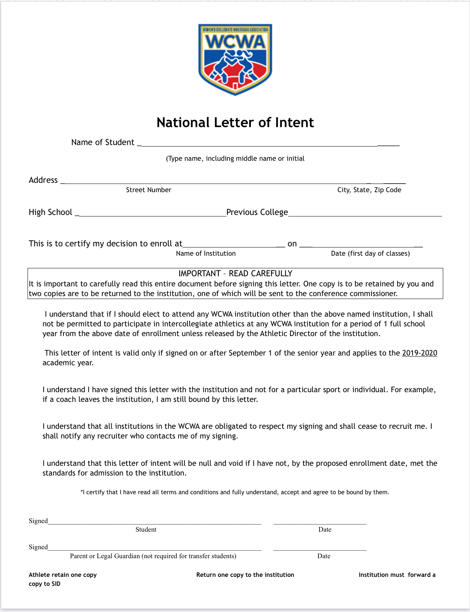
Letter of Intent
What you need to know

Slide 8
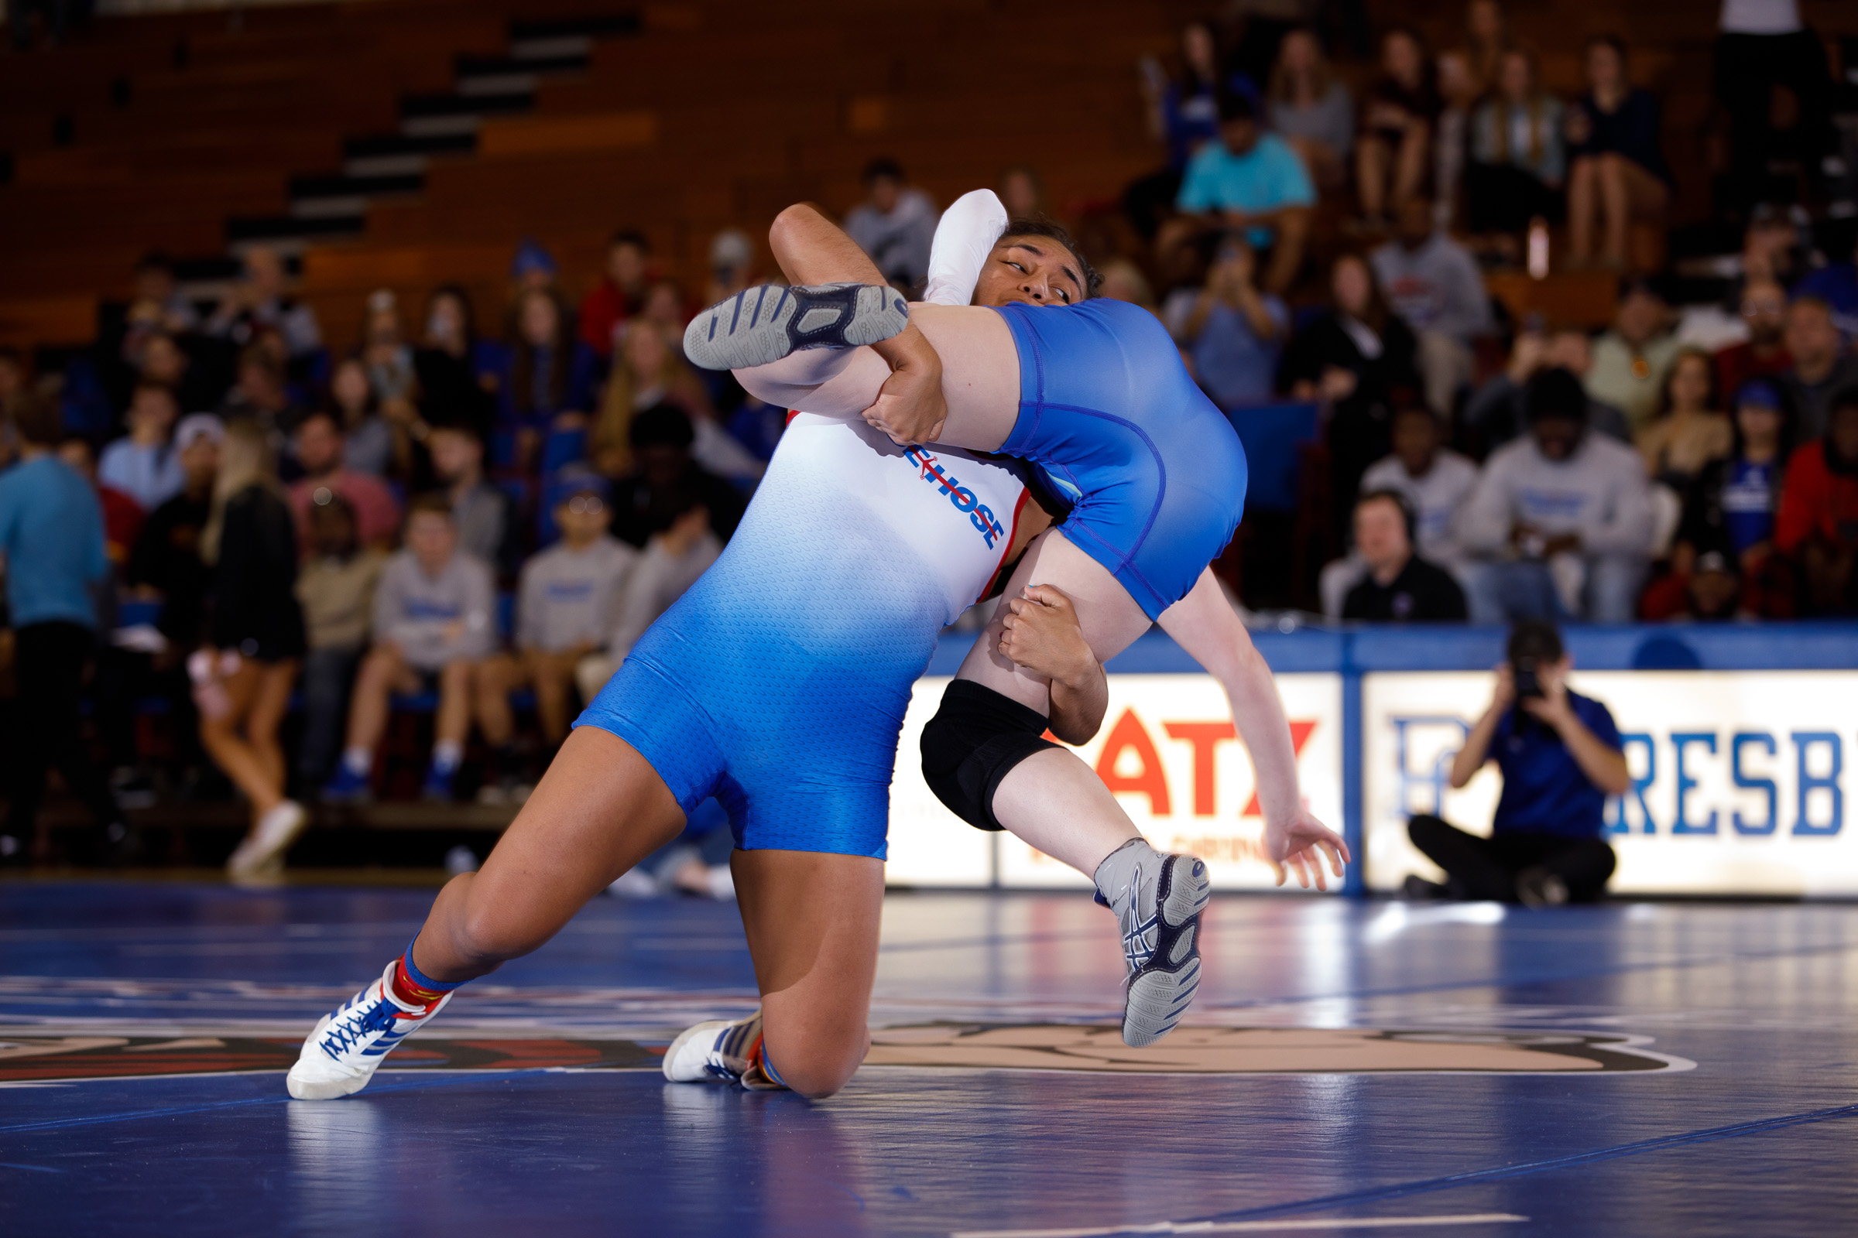
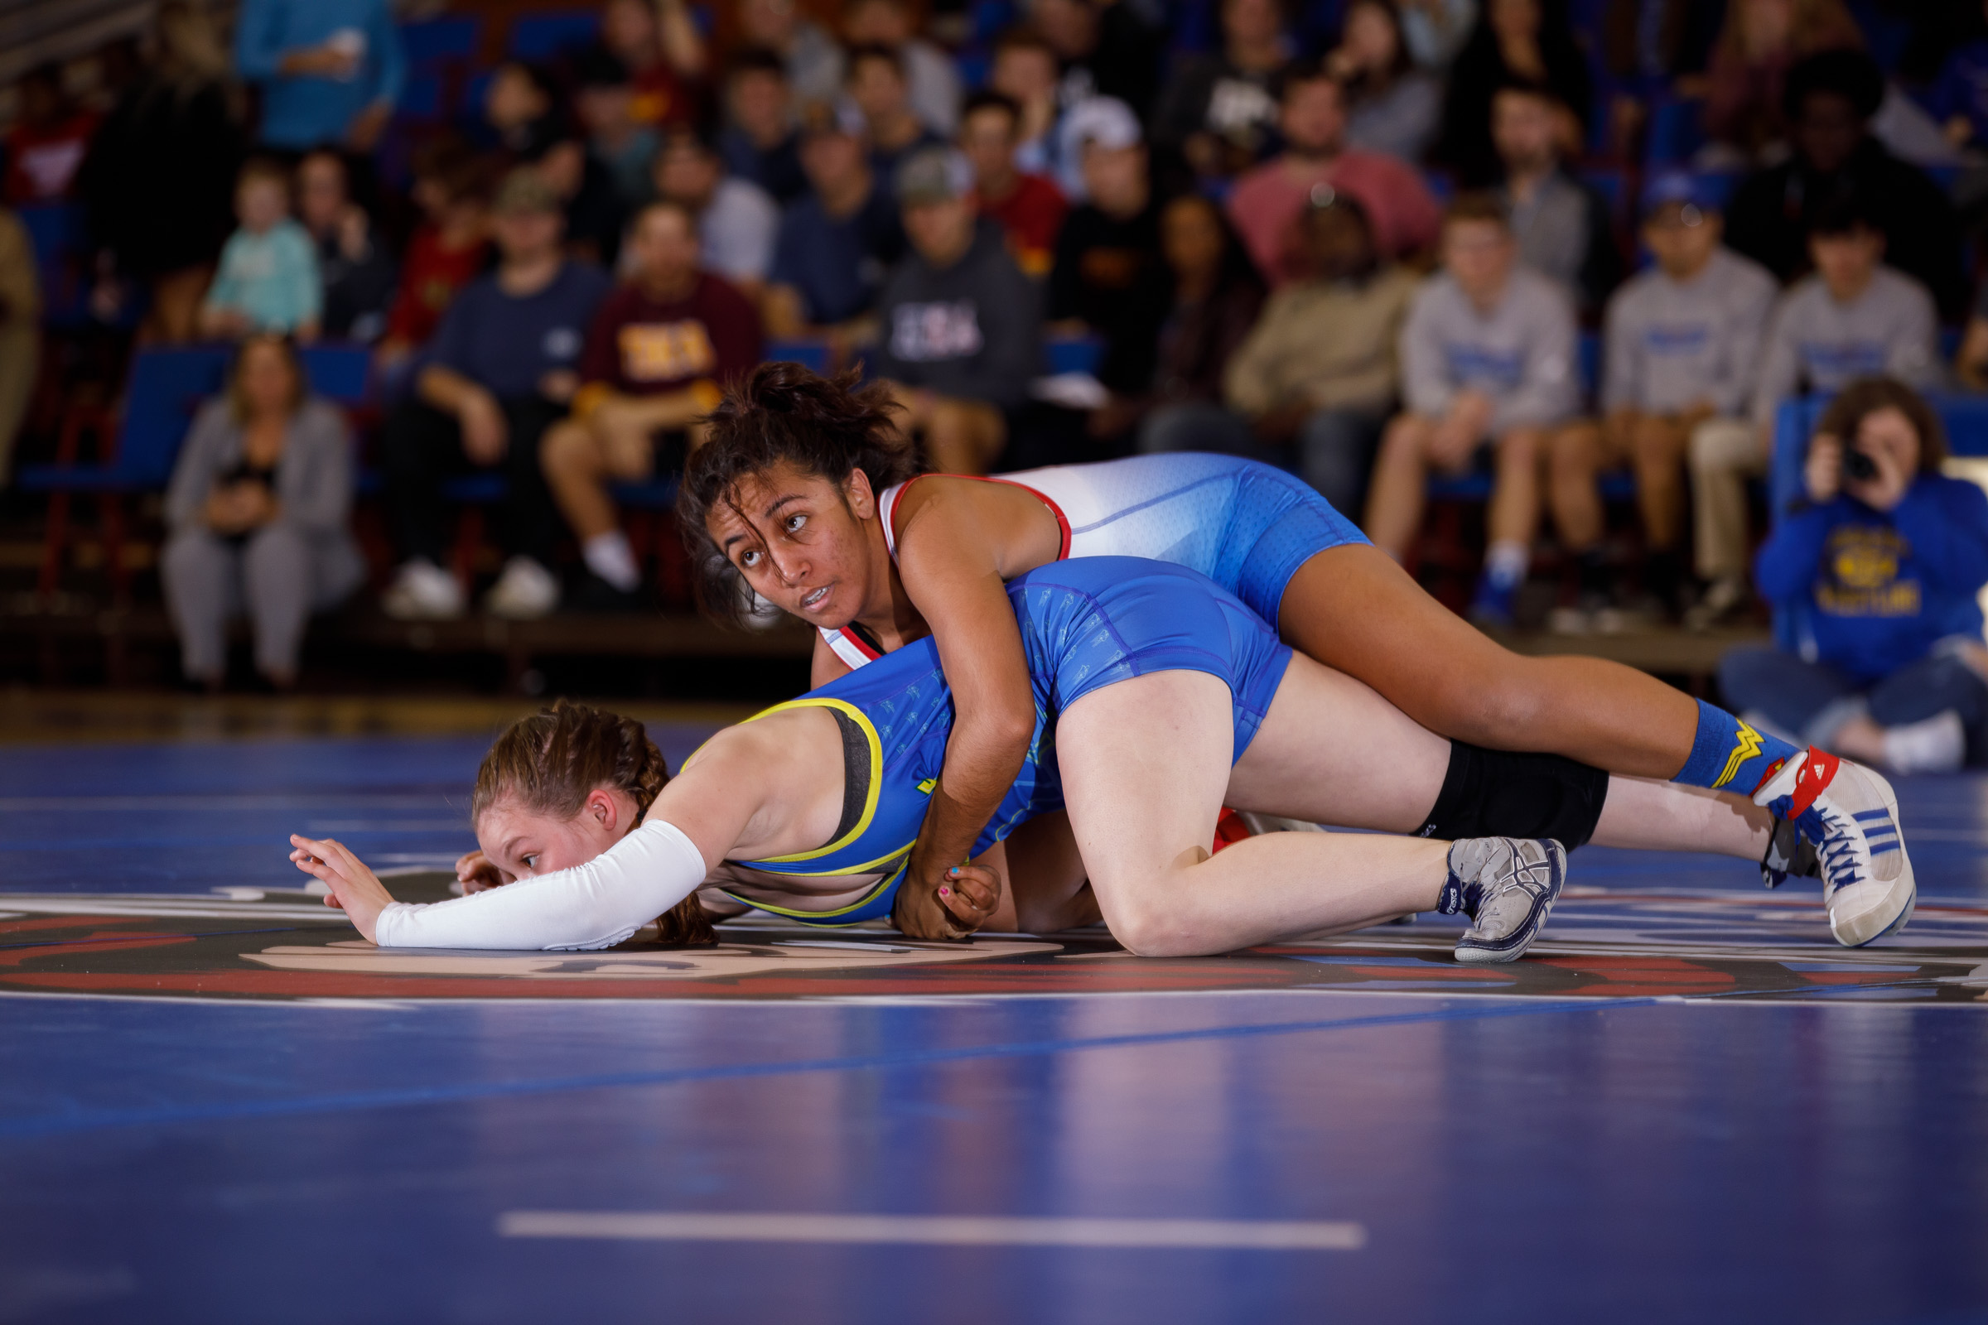
What coaches look for
What you need to know
Well rounded girls
Academically grounded
Low maintenance
Hard Working
Coachable

Slide 9


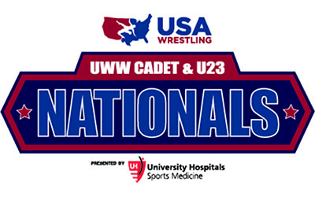
Tournament to keep in mind
What you need to know
State Championship
Folkstyle Nationals
UWW Cadets/Jr.
Fargo Nationals

Slide 10
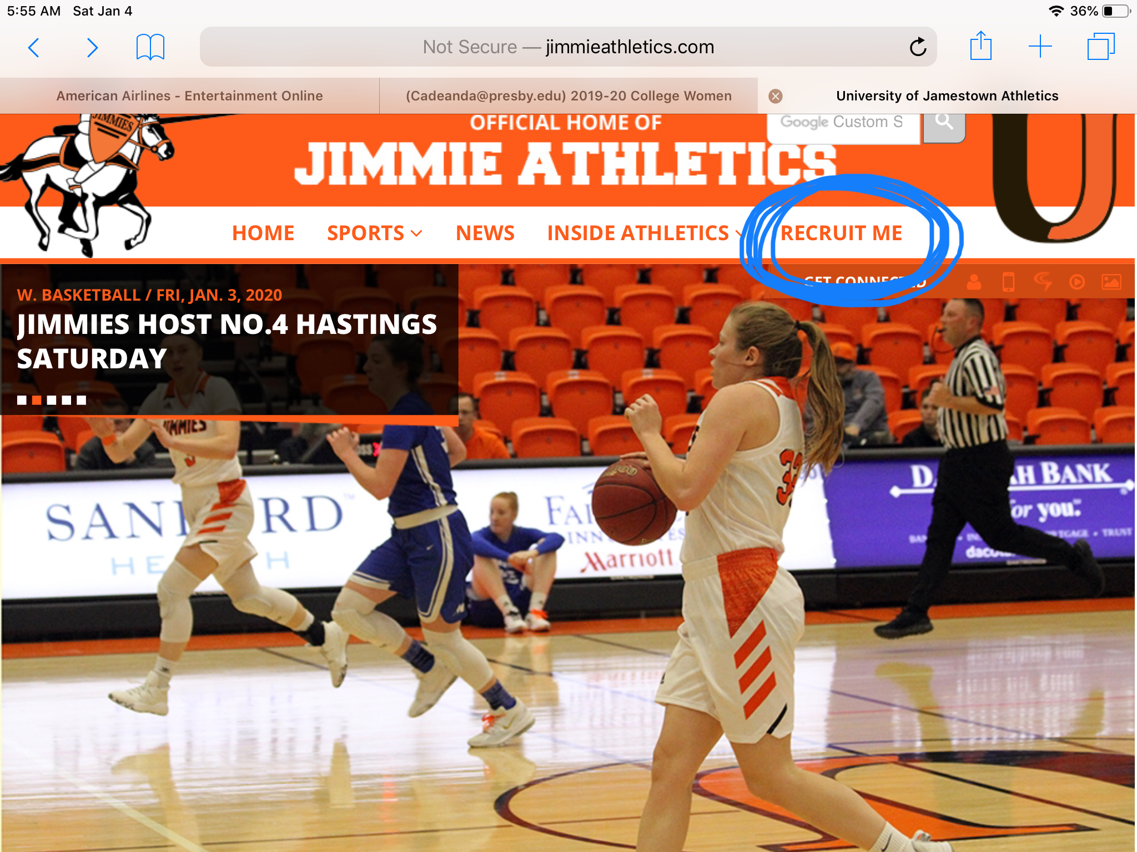
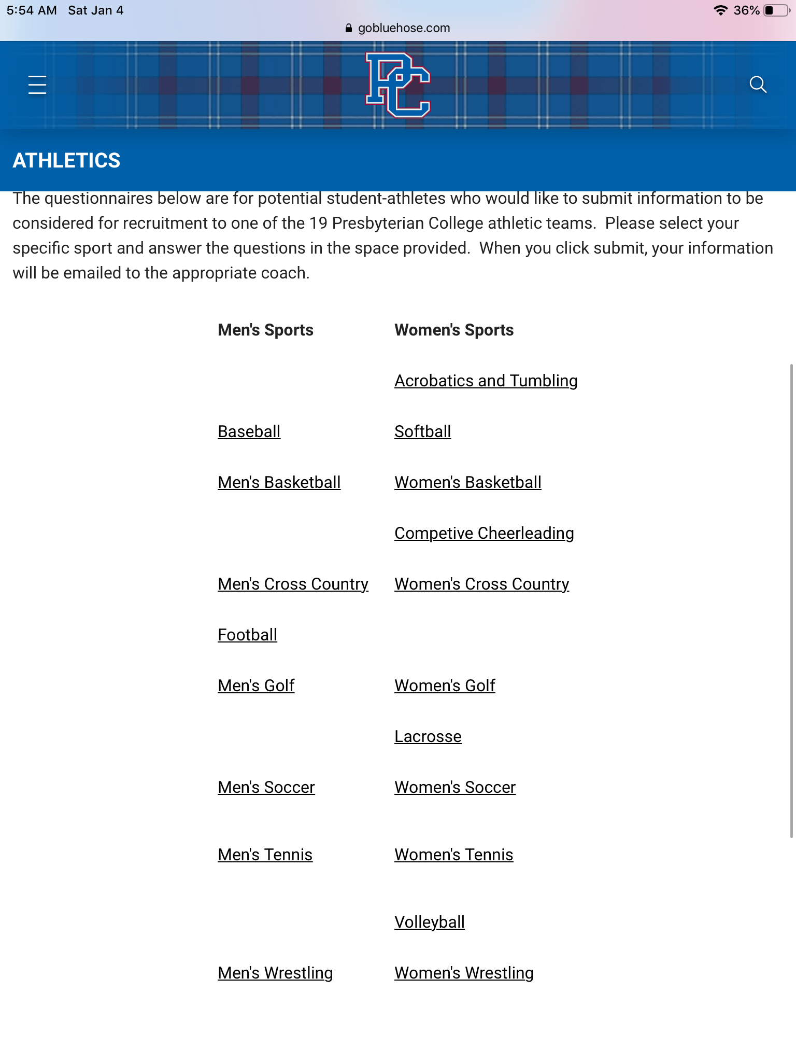
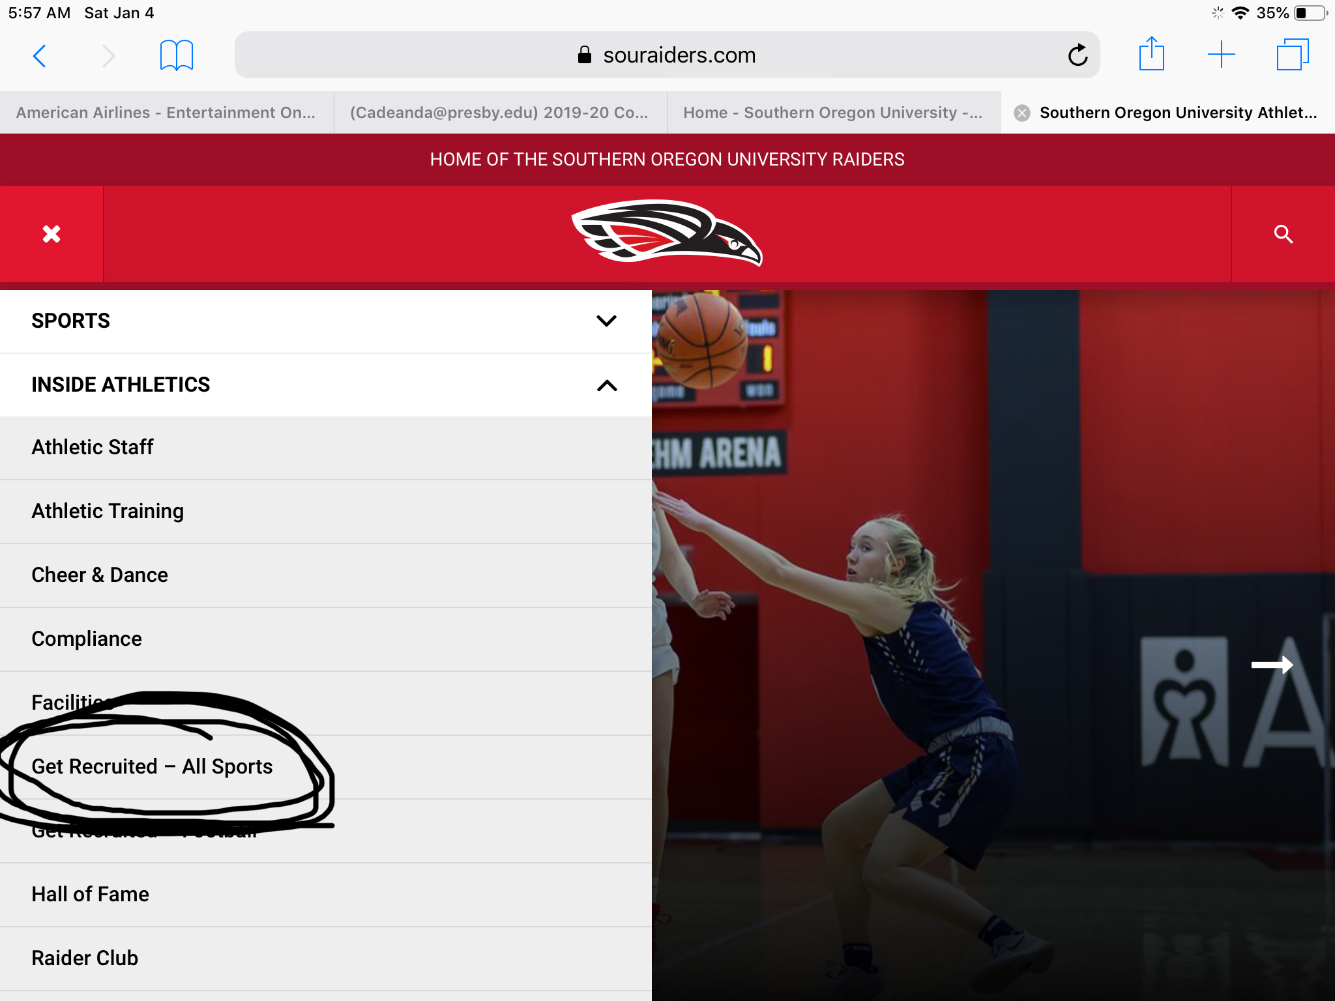
Recruit me and questionnaires

Slide 11
Helpful websites
What you need to know
www.transitionwrestling.com
www.themat.com
www.nwcaonline.com
www.collegiatewomenswrestling.org
https://studentaid.gov/h/apply-for-aid/fafsa
https://coachshannyn.com/girls

